Slide 1

DATA 621 – Final Project Stock Predictions Methods
Mael Illien
Salma Elshahawy
Dhairav Chhatbar

Slide 2
There are a few ways of predicting stock prices. From blind guessing to machine learning, many techniques have been tested to try to achieve decent results. Capturing the complexity of the market in a model is a daunting task but it can be broken down in a number of approaches.

Slide 3
The Data
EOD data for all Dow Jones stocks
This dataset provides free end of day data for all stocks currently in the Dow Jones Industrial Average. For each of the 30 components of the index, there is one CSV file named by the stock's symbol (e.g. AAPL for Apple). Each file provides historically adjusted market-wide data (daily, max. 5 years back).
30 Companies
36, 851 Observations
Range: 2/21/2014 - 2/20/2019
URL: https://www.kaggle.com/timoboz/stock-data-dow-jones?select=DIS.csv

Slide 4
The Data
Variable | Description
date | Trading Date
open | Price of the stock at market open
high | Highest price reached in the trade day
low | Lowest price reached in the trade day
close | Price of the stock at market close
volume | Number of shares traded
unadjustedVolume | Volume for stocks, unadjusted by stock splits
change | Change in closing price from prior trade day close
changePercent | Percentage change in closing price from prior trade day close
vwap | Volume weighted average price (VWAP) is the ratio of the value traded to total volume traded
label | Trading Date
changeOverTime | Percent change of each interval relative to first value. Useful for comparing multiple stocks.
ticker | Abbreviation used to uniquely identify publicly traded shares

Slide 5
The Data - Feature Engineering
Dataset augmented with engineered features believed to have predictive power
Variable | Description
MACD | the Moving Average Convergence Divergence signal (only) using the typical 12 and 26 window sizes
RSI | Relative Strength Indicator
M5 | momentum indicator over the last 5 days (moving average of one trading week)
M20 | momentum indicator over the last 20 days (moving average of one trading month)
Vol1 | rate of change of the volume over the last day
Vol5 | rate of change of the volume over the last five days (one trading week)

Slide 6
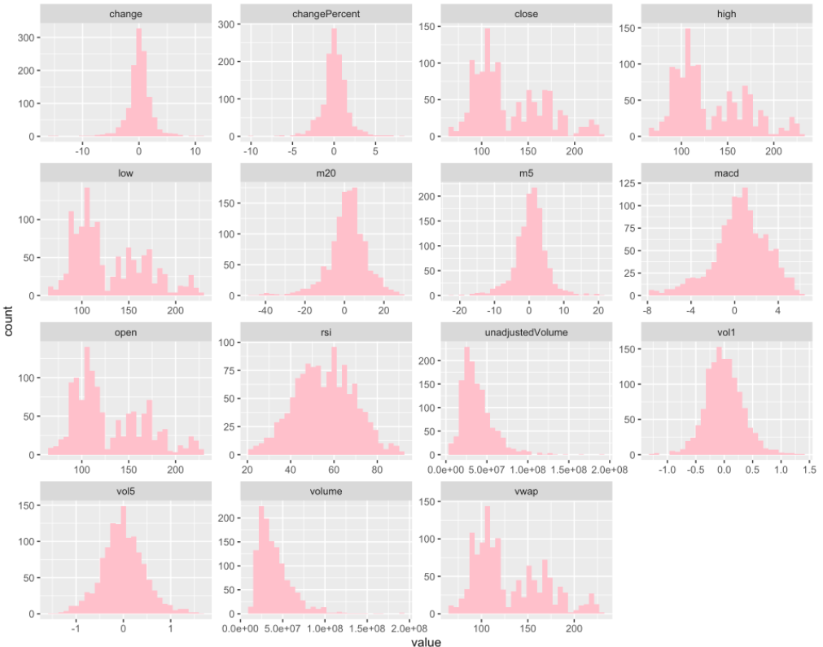
The Data
Distribution of base and engineered features

Slide 7
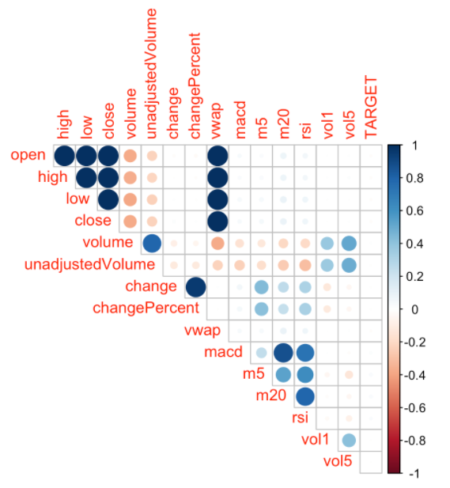
Correlation Matrix
Correlation matrix of base and engineered features

Slide 8
Models
Logistic
Auto Regressive
Panel
Full Model
Small Model
Multicollinearity Removed
Autoregressive Model
Generalized Least Squares
ARIMA
Pooled OLS
Fixed Effect
Within Estimator
First Difference Estimator
Random Effect

Slide 9
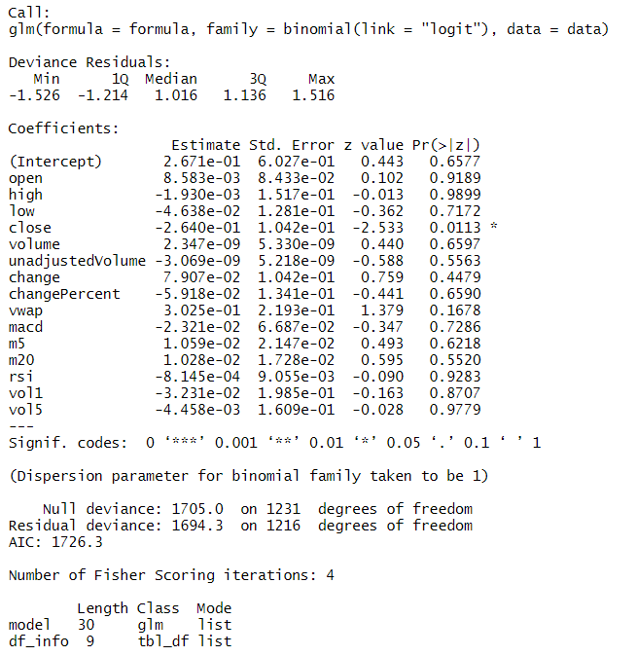
Logistic Model
Full Model
Only the `close` variable is significant
lot of the variables are multicollinear

Slide 10
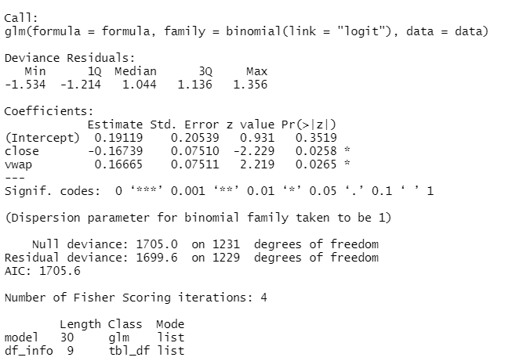
Logistic Model
Small Model
nonsensical results

Slide 11
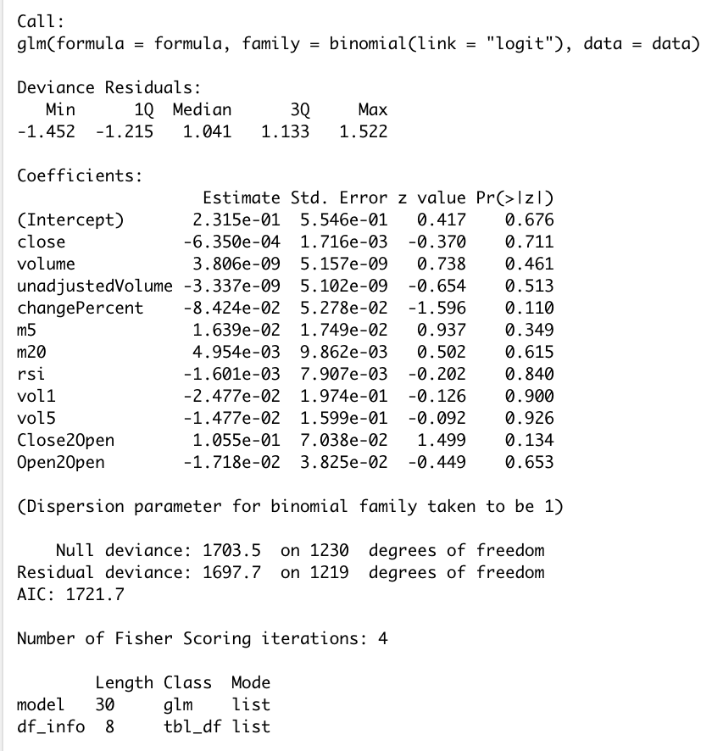
Logistic Model
Multicollinearity Removed
Model lacks significance

Slide 12
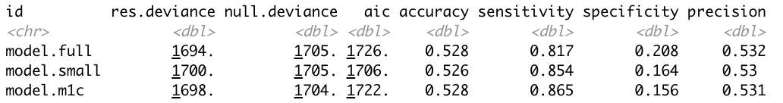
Logistic Model - Results
In-sample testing accuracy is fairly low at 52%
None of 3 models have any edge

Slide 13
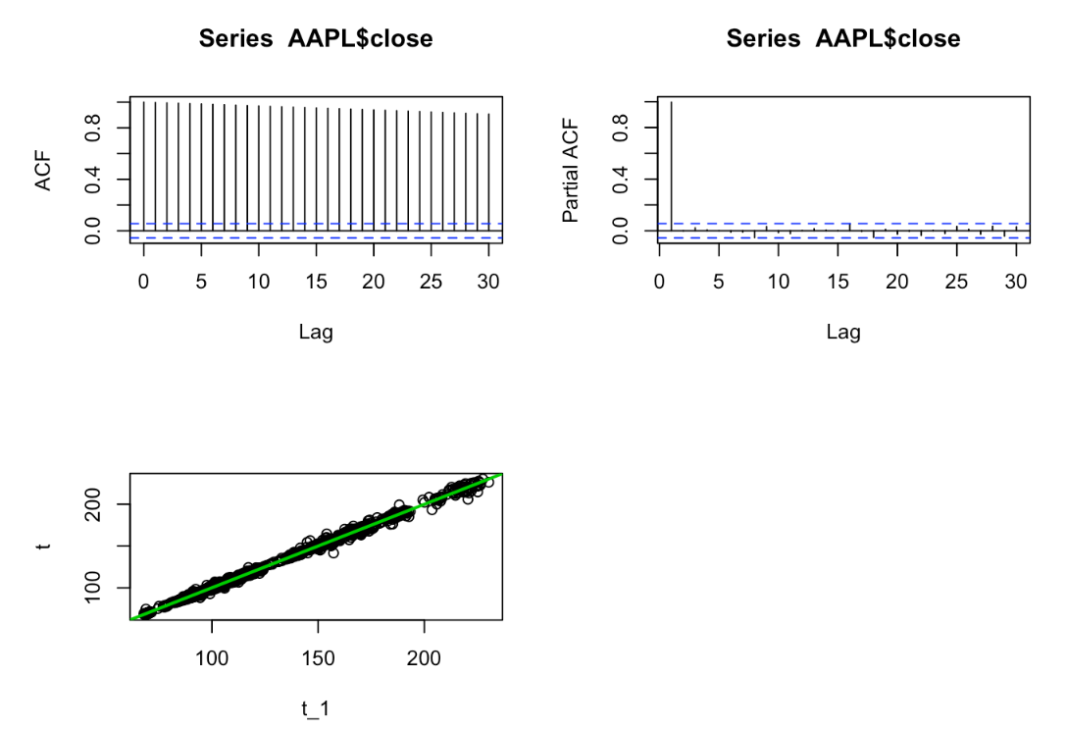
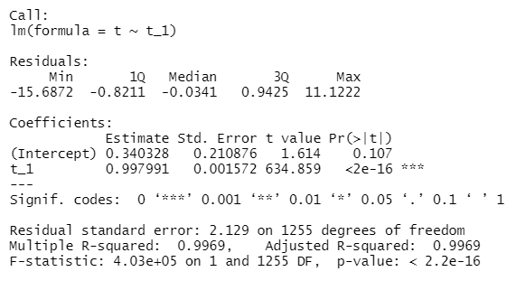
Auto-Regressive Model
Simple Regression
Lag 1 is significant suggesting an autoregressive model

Slide 14
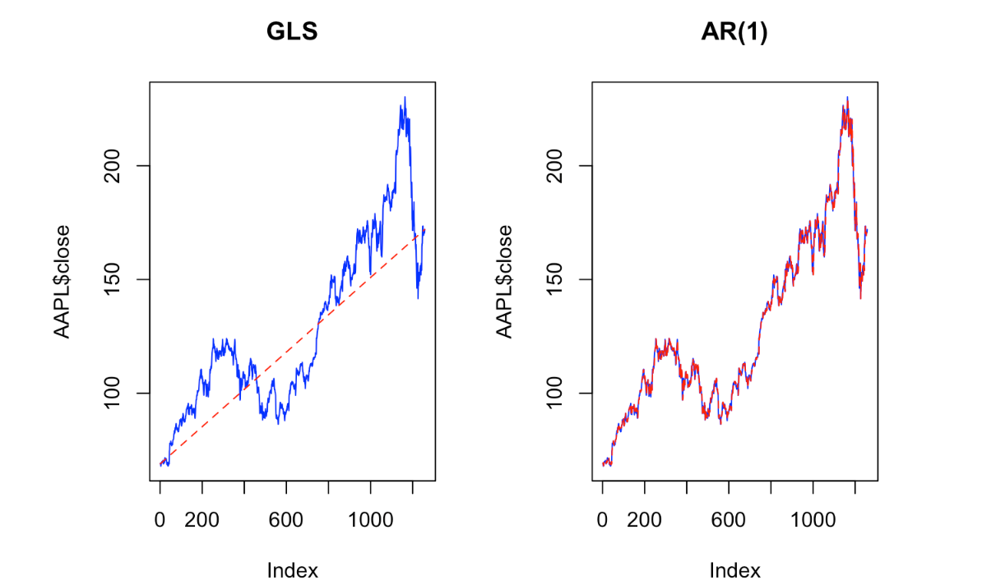
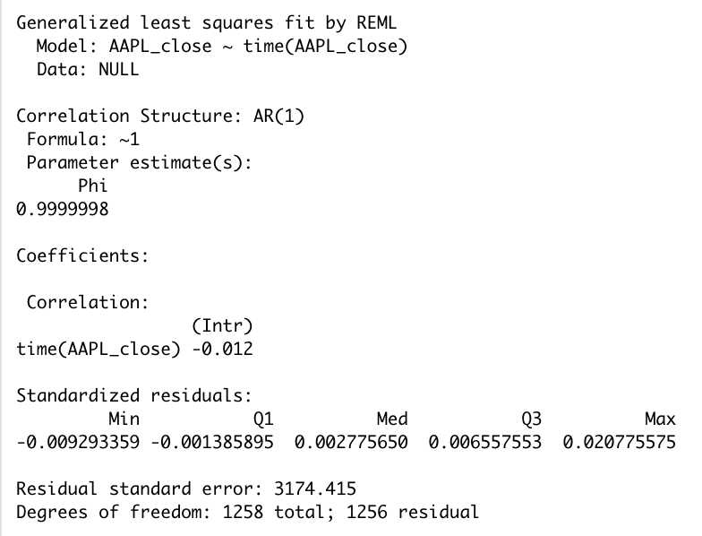
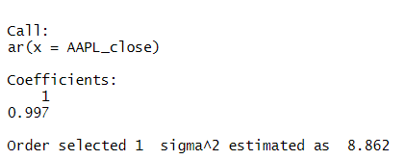
Auto-Regressive Model
Generalized Least Squares & Autoregressive Model
Order 1 coefficient consistent across methods
Likelyhood Ratio test confirm important of added AR term
Potential stationarity issue

Slide 15
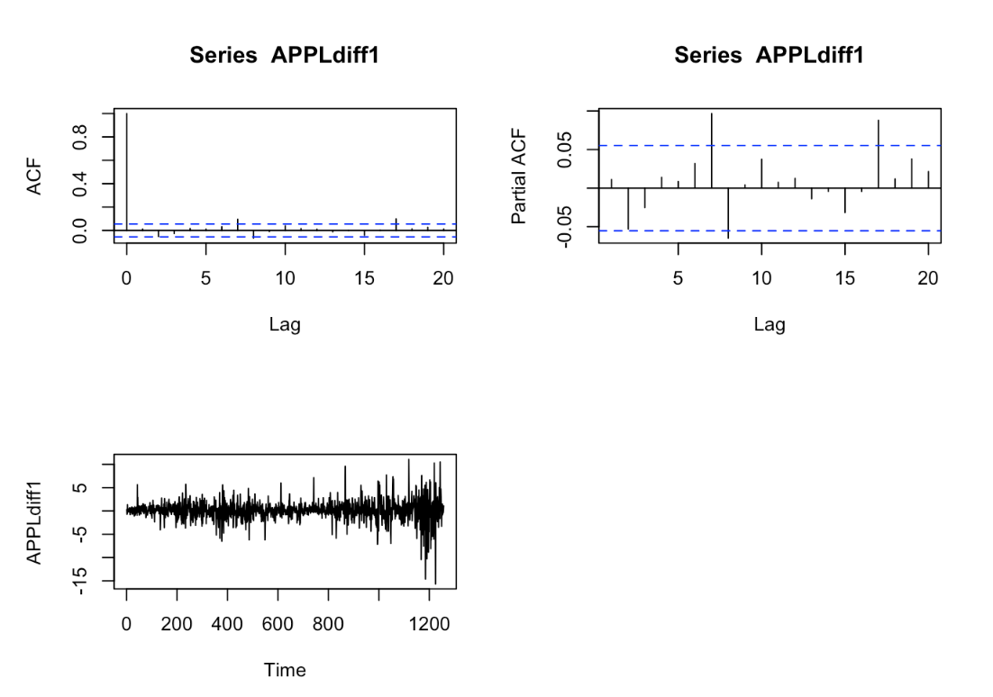
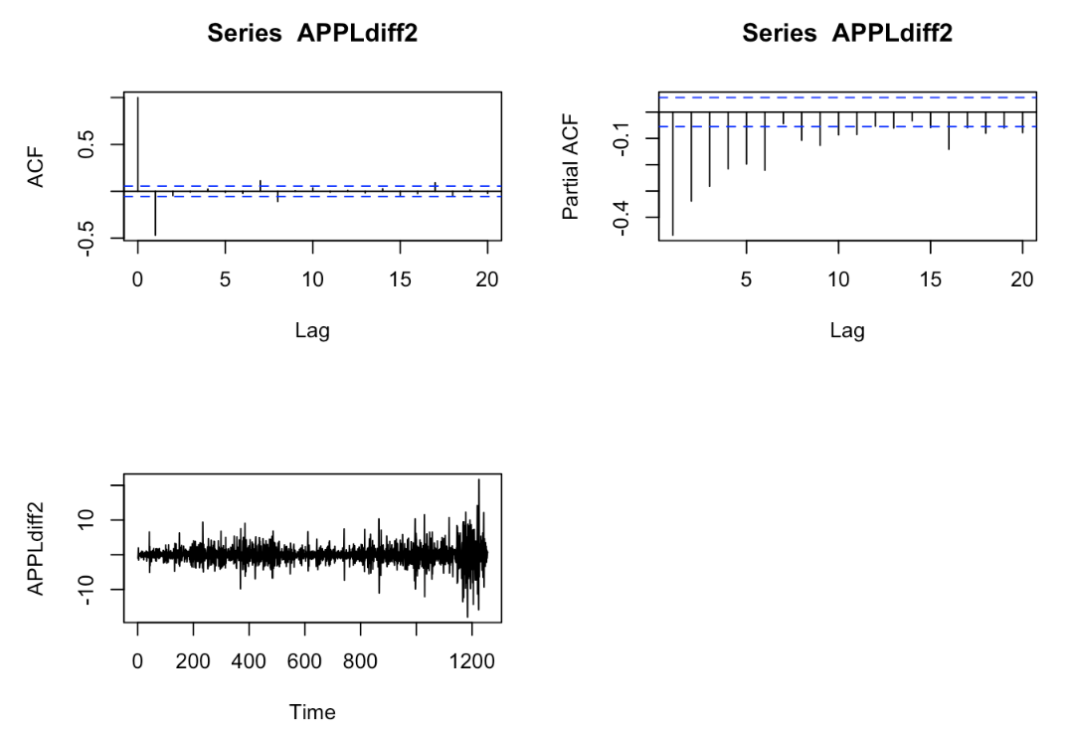
Auto-Regressive Model
ARIMA
Diagnose stationary issues
Determine AR, I and MA order for ARIMA model

Slide 16
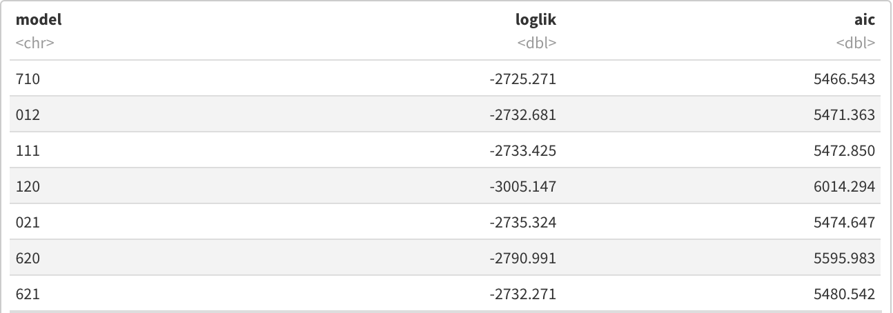
Auto-Regressive Model - Results
First Order ARIMA(7,1,0): AR(7) high order on the autoregressive structure
First Order ARIMA(0,1,2): MA(1) moving average structure
First Order ARIMA(1,1,1): ARMA(1,1) combination
Second Order ARIMA(1,2,0): AR(1) autoregressive structure
Second Order ARIMA(0,2,1): MA(1) moving average structure
Second Order ARIMA(6,2,0): AR(6) autoregressive structure
Second Order ARIMA(6,2,1): ARMA(6,1) combination

Slide 17
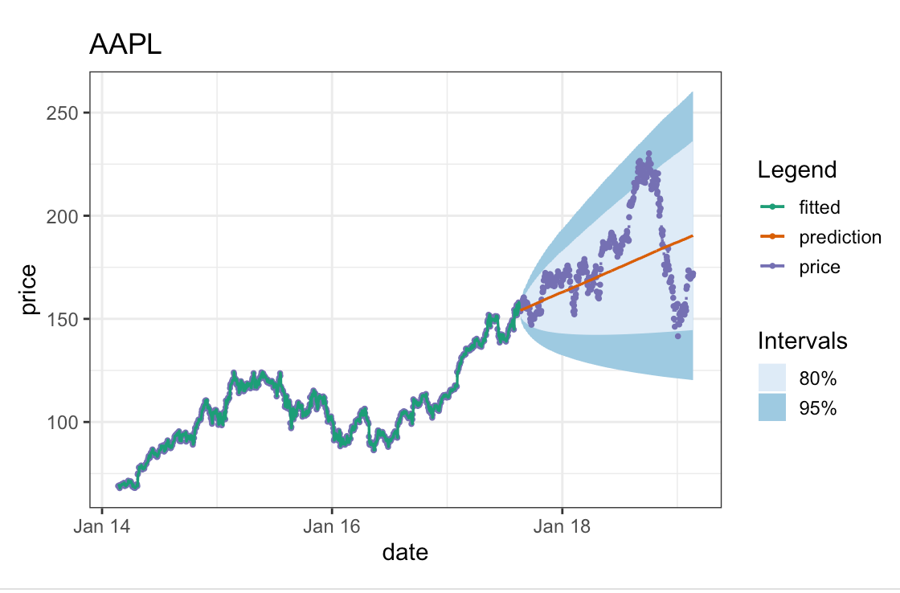
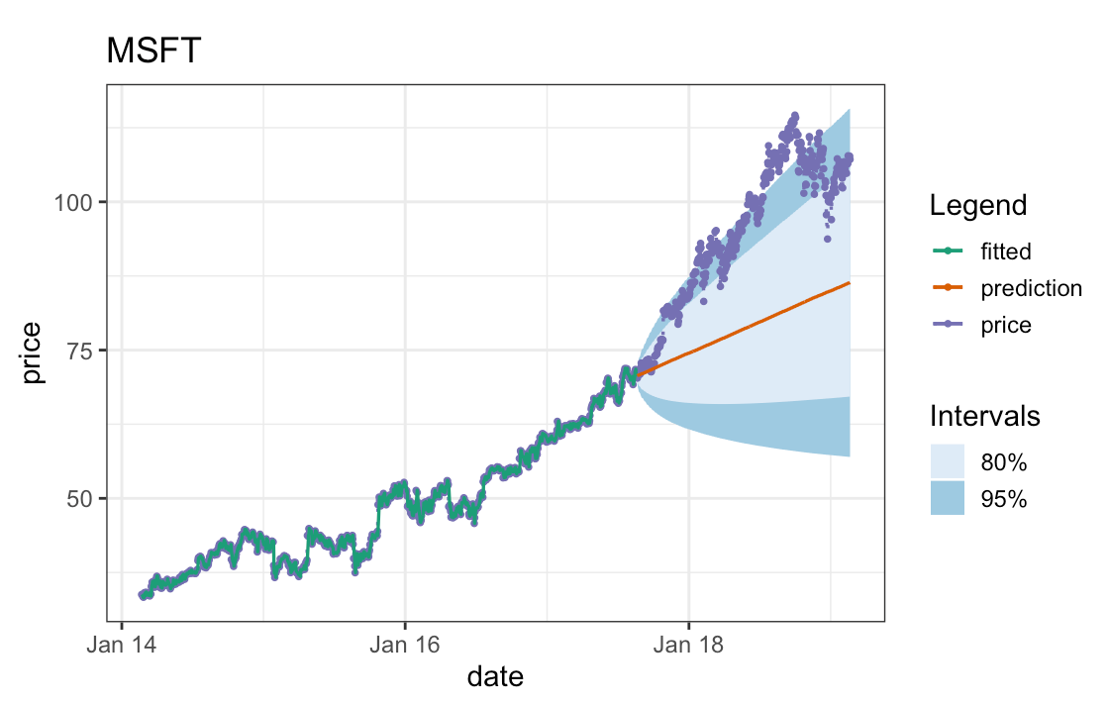
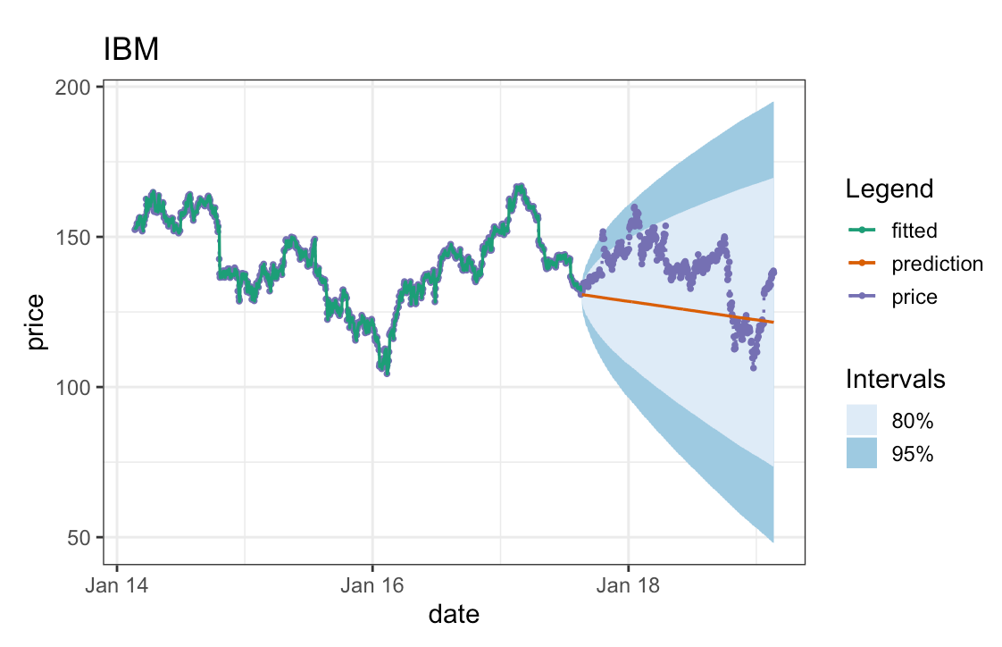
Auto-Regressive Model - Results

Slide 18

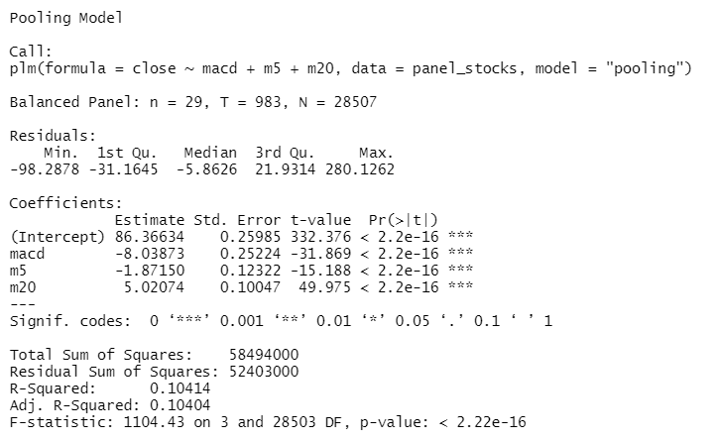
Panel Model
Pooled OLS Model
Ordinary Least Squares technique
Cross-sectional dimensions are ignored
Most restrictive panel model

Slide 19

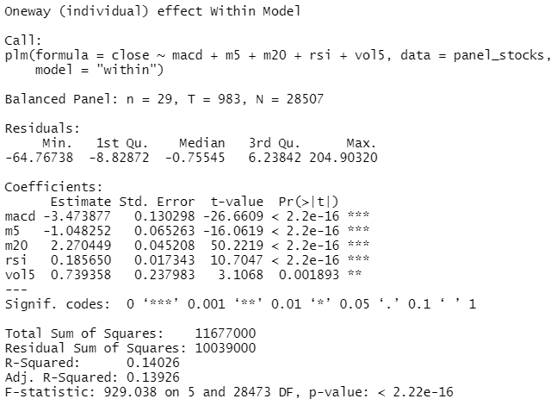
Panel Model
Fixed Effects Model
Within Estimator
Assumes there is an unobserved heterogeneity

Slide 20
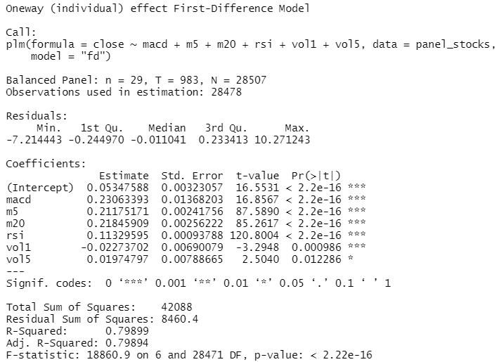
Panel Model
Fixed Effects Model
First Difference Estimator
Unobserved heterogeneity canceled out
Nonsensical fitted values

Slide 21

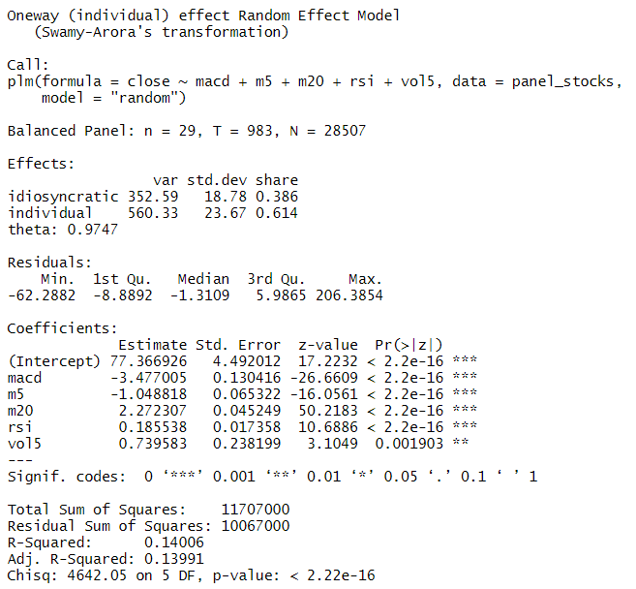
Panel Model
Random Effects Model
Assumes no fixed effects
unobserved heterogeneity not correlated with the predictor variables
unobserved heterogeneity randomly distributed with error term

Slide 22
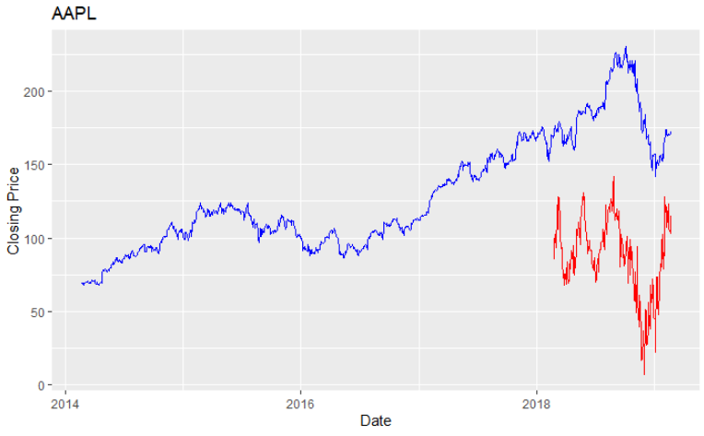
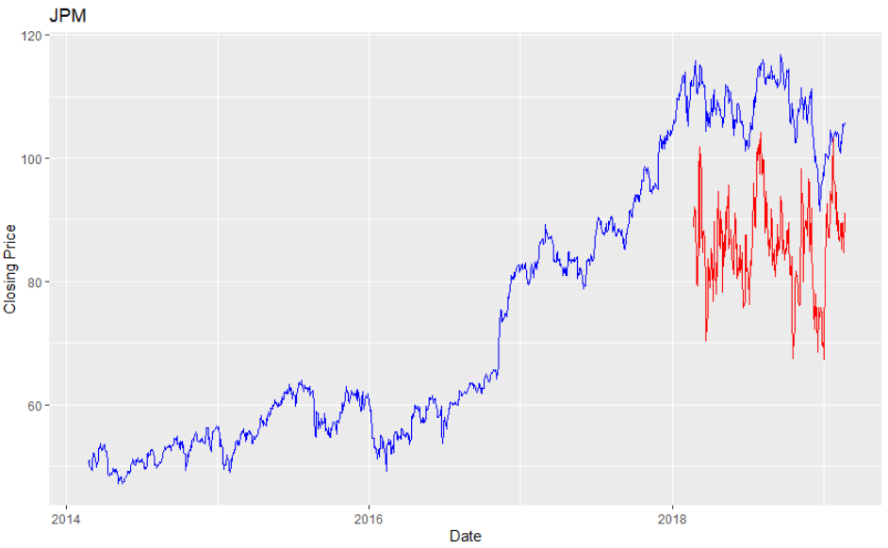
Panel Model - Results
Fixed Effect model most significant
Sporadic fitted values
Multicollinearity issues

Slide 23
Conclusion
Logistic Model: Hardly any of the predictor variable were significant, and the classification accuracies were around 52%, no different than guessing
Panel Model: Fixed Effect model most significant of all Panel models, but with adjusted R² only at around 14%
Auto-regressive Model: ARIMA model most suitable for general trend estimation/prediction

